Slide 1

Revenue At Potential Risk
WIDE WORLD IMPORTERS
GOAL OF THE SLIDES
Understand how sales performance has changed over time
Use that understanding to inform strategy
End with specific recommendations

Slide 2

Table of Contents
1
2
The Project Overview & Dashboard
Problem Area
3
4
Who Is at Stake & What's at Risk
Why Revenue Concentration Is a Risk
5
6
Big Idea + Approaches
Impact of Recommendations

Slide 3
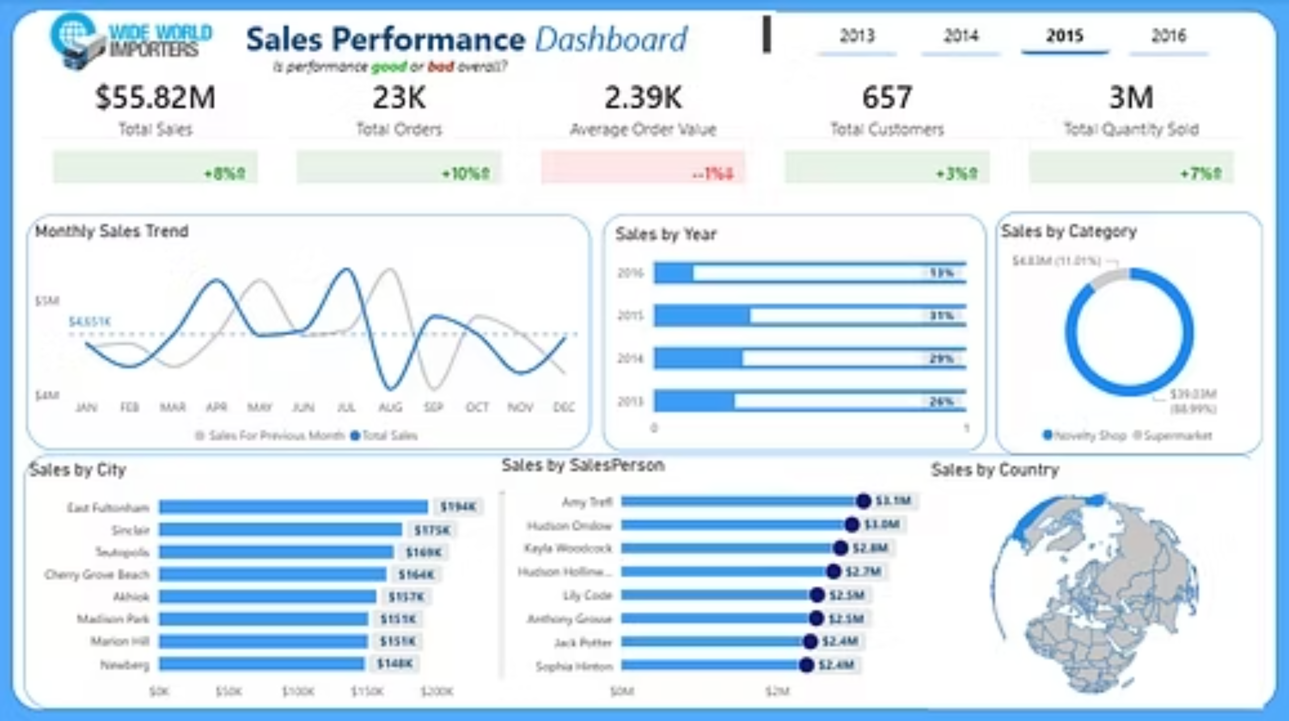
Wide World Importers - Sales Performance

Slide 4

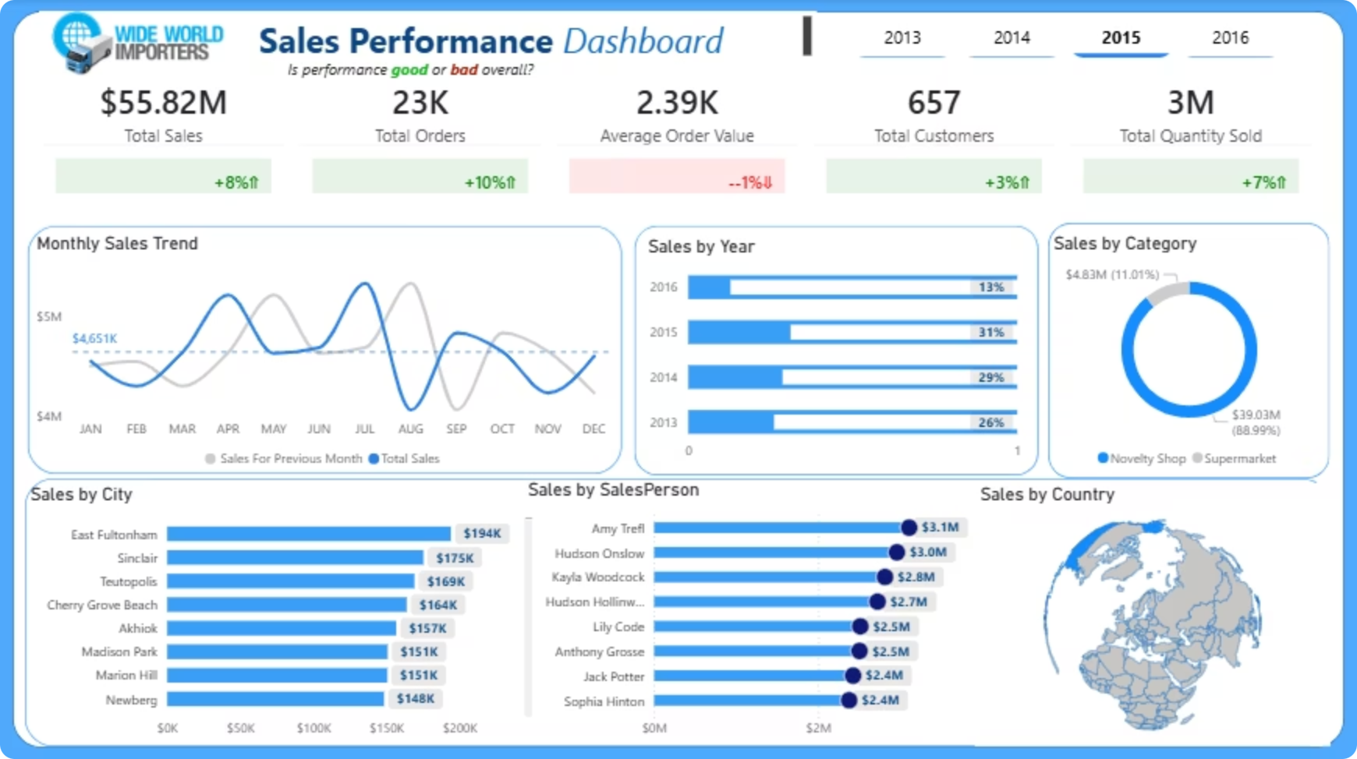

The Project Overview & Dashboard
This project analyzes historical sales performance for Wide World Importers to uncover hidden structural risks behind apparent revenue growth. While topline sales increased, deeper analysis reveals vulnerabilities that could threaten future revenue stability and scalability if left unaddressed.
Key metrics at a glance for (2014–2015):
Total Sales: $55.82M (+8% YoY)
Total Orders: 23K (+10%)
Customers: 657 (+3% growth )
Avg Order Value: $2.39K (declining)
Monthly volatility hidden under yearly gains
Heavy concentration: Novelty Shops ~89%, few top cities/reps

Slide 5

Problem Area
Although revenue increased year over year, the growth pattern exposed potential revenue risks once customer behavior and sales structure were fully analyzed.
Weak customer growth relative to revenue increase
Declining average order value, signaling pressure on pricing or customer quality
Extreme geographic and rep concentration, increasing exposure to localized shocks
Severe monthly sales volatility masked by yearly totals
Volume-led growth, which is harder to sustain long-term than value-led growth
These factors indicate that current performance, while positive, is fragile.

Slide 6

Who Is at Stake & What's at Risk
Who is at stake:
What's at stake:
Executive leadership
Revenue stagnation if customer acquisition slows
Boards & investors
Overdependence on a small number of cities, categories, or top performers
Finance and sales leadership
Margin erosion driven by falling order values
Cash-flow instability from unpredictable monthly performance
Reduced ability to scale profitably
Without decisive action, the business risks turning strong historical performance into fragile future results.

Slide 7

Why Revenue Concentration Is a Risk
Focusing resources on top-performing categories, cities, and sales representatives can drive short-term growth. However, in this case, the analysis shows that revenue is heavily concentrated while customer growth is weak and average order value is declining.
This creates dependency risk: revenue becomes overly reliant on a small number of segments and individuals. Any disruption — such as the loss of a key customer, city, or sales rep — could materially impact overall performance.
The issue is not strategic focus itself, but over-concentration without expansion. Without broadening the customer base and stabilizing demand across regions, current growth becomes fragile and difficult to sustain long-term.

Slide 8

Big Idea + Approaches
Big Idea
Turn surface-level growth into clear, risk-aware decisions that protect revenue and enable sustainable expansion.
Analyze revenue drivers beyond topline growth.
Identify structural weaknesses hidden in aggregated metrics
Translate insights into clear, actionable leadership decisions
Focus on sustainability, not just short-term performance.

Slide 9




Impact of Recommendations
These four high-impact decisions deliver immediate protection and long-term growth:
Accelerate customer acquisition
Revive underperforming cities
Restores positive customer growth (ends slow growth)
Reduces geographic concentration risk
Optimize sales territories & rep performance
Stabilize monthly volatility now
Narrows productivity gaps and lifts average revenue per rep
Fixes inventory, promotions, and coverage root causes for predictable revenue
Overall Impact
Protects $55.82M base from erosion
Unlocks sustainable, value-led growth not volume led
Improves resilience against market and operational shocks
Builds leadership confidence with clear, risk-aware decisions
Leadership can execute these strategies now.

